Slide 1
Pointers and Dynamic Memory Allocation

Slide 2
Pointers
Pointers
Powerful feature of the C++ language
One of the most difficult to master
Essential for construction of interesting data structures

Slide 3
Introduction to Pointers
When we declare a variable some memory is allocated for it. Thus, we have two properties for any variable : its address and its data value. The address of the variable can be accessed through the referencing operator “&”. “&i” gives the memory location where the data value for “i” is stored.
A pointer variable is one that stores an address. We can declare pointers as follows int *p; This means that p stores the address of a variable of type int.

Slide 4
Addresses and Pointers
C++ allows two ways of accessing variables
Name (C++ keeps track of the address of the first location allocated to the variable)
Address/Pointer
Symbol & gets the address of the variable that follows it
Addresses/Pointers can be displayed by the cout statement
Addresses displayed in HEXADECIMAL

Slide 5
Example
#include <iostream.h>
void main( )
{
int data = 100;
float value = 56.47;
cout << data << &data << endl;
cout << value << &value << endl;
}
Output:
100 FFF4
56.47 FFF0
FFF0
56.47
value
FFF1
FFF2
FFF3
data
FFF4
100
FFF5
FFF6

Slide 6
Pointer Variables
The pointer data type
A data type for containing an address rather than a data value
Integral, similar to int
Size is the number of bytes in which the target computer stores a memory address
Provides indirect access to values

Slide 7
Reference Variables
A reference is an additional name to an existing memory location
Pointer:
x
ref
int x=9;
int *ref;
ref = &x;
Reference:
X
ref
int x = 9;
int &ref = x;
9
9

Slide 8
Declaration of Pointer Variables
A pointer variable is declared by:
dataType *pointerVarName;
The pointer variable pointerVarName is used to point to a value of type dataType
The * before the pointerVarName indicates that this is a pointer variable, not a regular variable
The * is not a part of the pointer variable name

Slide 9
Declaration of Pointer Variables (Cont ..)
Example
int *ptr1;
float *ptr2;
ptr1 is a pointer to an int value i.e., it can have the address of the memory location (or the first of more than one memory locations) allocated to an int value
ptr2 is a pointer to a float value i.e., it can have the address of the memory location (or the first of more than one memory locations) allocated to a float value

Slide 10
Declaration of Pointer Variables (Cont ..)
Whitespace doesn’t matter and each of the following will declare ptr as a pointer (to a float) variable and data as a float variable
float *ptr, data;
float* ptr, data;
float (*ptr), data;
float data, *ptr;

Slide 11
Assignment of Pointer Variables
A pointer variable has to be assigned a valid memory address before it can be used in the program
Example:
float data = 50.8;
float *ptr;
ptr = &data;
This will assign the address of the memory location allocated for the floating point variable data to the pointer variable ptr. This is OK, since the variable data has already been allocated some memory space having a valid address

Slide 12
Assignment of Pointer Variables (Cont ..)
float data = 50.8;
float *ptr;
ptr = &data;
FFF0
FFF1
FFF2
FFF3
data
FFF4
50.8
FFF5
FFF6

Slide 13
Assignment of Pointer Variables (Cont ..)
float data = 50.8;
float *ptr;
ptr = &data;
ptr
FFF0
FFF1
FFF2
FFF3
data
FFF4
50.8
FFF5
FFF6

Slide 14
Assignment of Pointer Variables (Cont ..)
float data = 50.8;
float *ptr;
ptr = &data;
ptr
FFF0
FFF4
FFF1
FFF2
FFF3
data
FFF4
50.8
FFF5
FFF6

Slide 15
Assignment of Pointer Variables (Cont ..)
Don’t try to assign a specific integer value to a pointer variable since it can be disastrous
float *ptr;
ptr = 120;
You cannot assign the address of one type of variable to a pointer variable of another type even though they are both integrals
int data = 50;
float *ptr;
ptr = &data;

Slide 16
Initializing pointers
A pointer can be initialized during declaration by assigning it the address of an existing variable
float data = 50.8;
float *ptr = &data;
If a pointer is not initialized during declaration, it is wise to give it a NULL (0) value
int *ip = 0;
float *fp = NULL;

Slide 17
The NULL pointer
The NULL pointer is a valid address for any data type.
But NULL is not memory address 0.
It is an error to dereference a pointer whose value is NULL.
Such an error may cause your program to crash, or behave erratically.
It is the programmer’s job to check for this.

Slide 18
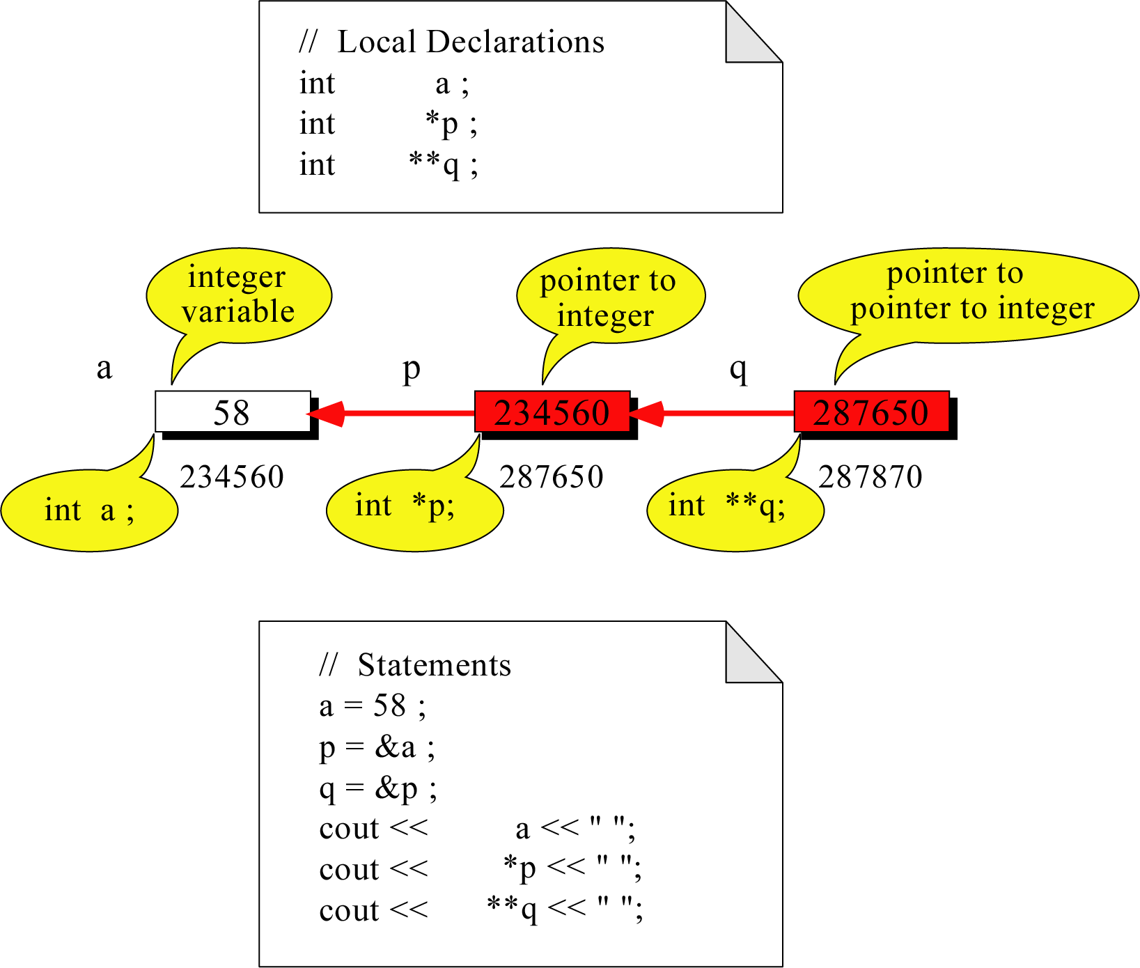
Pointer to Pointer
What is the output?
58 58 58

Slide 19
Pointer Arithmetic
Some arithmetic operators can be used with pointers:
Increment and decrement operators ++, --
Integers can be added to or subtracted from pointers using the operators +, -, +=, and -=
One pointer can be subtracted from another by using the subtraction operator

Slide 20
Pointer Arithmetic
Assume the variable definitions
int vals[]={4,7,11};
int *valptr = vals;
Examples of use of ++ and --
valptr++; // points at 7
valptr--; // now points at 4

Slide 21
Pointer Arithmetic
Assume the variable definitions:
int vals[]={4,7,11};
int *valptr = vals;
Example of the use of + to add an int to a pointer:
cout << *(valptr + 2)
This statement will print 11

Slide 22
Comparing Pointers
Relational operators can be used to compare addresses in pointers
Comparing addresses in pointers is not the same as comparing contents pointed at by pointers:
if (ptr1 == ptr2) // compares
// addresses
if (*ptr1 == *ptr2) // compares
// contents

Slide 23
Dereferencing
Dereferencing – Using a pointer variable to access the value stored at the location pointed by the variable
Provide indirect access to values and also called indirection
Done by using the dereferencing operator * in front of a pointer variable
Unary operator
Highest precedence

Slide 24
Dereferencing (Cont ..)
Example:
float data = 50.8;
float *ptr;
ptr = &data;
cout << *ptr;
Once the pointer variable ptr has been declared, *ptr represents the value pointed to by ptr (or the value located at the address specified by ptr) and may be treated like any other variable of float type

Slide 25
Dereferencing (Cont ..)
The dereferencing operator * can also be used in assignments.
*ptr = 200;
Make sure that ptr has been properly initialized

Slide 26
Dereferencing Example
#include <iostream.h>
void main()
{
float data = 50.8;
float *ptr;
ptr = &data;
cout << ptr << *ptr << endl;
*ptr = 27.4;
cout << *ptr << endl;
cout << data << endl;
}
Output:
ptr
FFF0
FFF4
FFF1
FFF2
FFF3
data
FFF4
50.8
FFF5
FFF6

Slide 27
Dereferencing Example (Cont ..)
#include <iostream.h>
void main()
{
float data = 50.8;
float *ptr;
ptr = &data;
cout << ptr << *ptr << endl;
*ptr = 27.4;
cout << *ptr << endl;
cout << data << endl;
}
Output:
FFF4 50.80
ptr
FFF0
FFF4
FFF1
FFF2
FFF3
data
FFF4
50.8
FFF5
FFF6

Slide 28
Dereferencing Example (Cont ..)
#include <iostream.h>
void main()
{
float data = 50.8;
float *ptr;
ptr = &data;
cout << ptr << *ptr << endl;
*ptr = 27.4;
cout << *ptr << endl;
cout << data << endl;
}
Output:
ptr
FFF0
FFF4
FFF1
FFF2
FFF3
data
FFF4
27.4
FFF5
FFF6

Slide 29
Dereferencing Example (Cont ..)
#include <iostream.h>
void main()
{
float data = 50.8;
float *ptr;
ptr = &data;
cout << ptr << *ptr << endl;
*ptr = 27.4;
cout << *ptr << endl;
cout << data << endl;
}
Output:
27.4
ptr
FFF0
FFF4
FFF1
FFF2
FFF3
data
FFF4
27.4
FFF5
FFF6

Slide 30
Dereferencing Example (Cont ..)
#include <iostream.h>
void main()
{
float data = 50.8;
float *ptr;
ptr = &data;
cout << ptr << *ptr << endl;
*ptr = 27.4;
cout << *ptr << endl;
cout << data << endl;
}
Output:
27.4
ptr
FFF0
FFF4
FFF1
FFF2
FFF3
data
FFF4
27.4
FFF5
FFF6

Slide 31
Operations on Pointer Variables
Assignment – the value of one pointer variable can be assigned to another pointer variable of the same type
Relational operations - two pointer variables of the same type can be compared for equality, and so on
Some limited arithmetic operations
integer values can be added to and subtracted from a pointer variable
value of one pointer variable can be subtracted from another pointer variable

Slide 32
Dynamic Memory Allocation

Slide 33
Allocation of Memory
Static Allocation: Allocation of memory space at compile time.
Dynamic Allocation: Allocation of memory space at run time.

Slide 34
Dynamic Memory Allocation
Can allocate storage for a variable while program is running
Uses new operator to allocate memory
double *dptr;
dptr = new double;
new returns address of memory location

Slide 35
Dynamic Memory Allocation
Can also use new to allocate array
arrayPtr = new double[25];
Program often terminates if there is not sufficient memory
Can then use [ ] or pointer arithmetic to access array

Slide 36
Releasing Dynamic Memory
Use delete to free dynamic memory
delete dptr;
Use delete [] to free dynamic array memory
delete [] arrayptr;
Only use delete with dynamic memory!
Notes:
See pr10-14.cpp

Slide 37
Example
int *ptr;
ptr = new int;
*ptr = 22;
cout << *ptr << endl;
delete ptr;
ptr = NULL;
ptr
FDE0
FDE1
FDE2
FDE3
0EC4
0EC5
0EC6
0EC7

Slide 38
Example (Cont ..)
int *ptr;
ptr = new int;
*ptr = 22;
cout << *ptr << endl;
delete ptr;
ptr = NULL;
ptr
FDE0
0EC4
FDE1
FDE2
FDE3
0EC4
0EC5
0EC6
0EC7

Slide 39
Example (Cont ..)
int *ptr;
ptr = new int;
*ptr = 22;
cout << *ptr << endl;
delete ptr;
ptr = NULL;
ptr
FDE0
0EC4
FDE1
FDE2
FDE3
0EC4
22
0EC5
0EC6
0EC7

Slide 40
Example (Cont ..)
int *ptr;
ptr = new int;
*ptr = 22;
cout << *ptr << endl;
delete ptr;
ptr = NULL;
ptr
FDE0
0EC4
FDE1
FDE2
FDE3
0EC4
22
Output:
22
0EC5
0EC6
0EC7

Slide 41
Example (Cont ..)
int *ptr;
ptr = new int;
*ptr = 22;
cout << *ptr << endl;
delete ptr;
ptr = NULL;
ptr
FDE0
?
FDE1
FDE2
FDE3
0EC4
0EC5
0EC6
0EC7

Slide 42
Example (Cont ..)
int *ptr;
ptr = new int;
*ptr = 22;
cout << *ptr << endl;
delete ptr;
ptr = NULL;
ptr
FDE0
0
FDE1
FDE2
FDE3
0EC4
0EC5
0EC6
0EC7

Slide 43
Memory leaks and
Dangling Pointers

Slide 44
Memory leaks
When you dynamically create objects, you can access them through the pointer which is assigned by the new operator
Reassigning a pointer without deleting the memory it pointed to previously is called a memory leak
It results in loss of available memory space

Slide 45
Memory leak example
ptr1
int *ptr1 = new int;
int *ptr2 = new int;
*ptr1 = 8;
*ptr2 = 5;
8
ptr2
5
ptr2 = ptr1;
ptr1
8
How to avoid?
ptr2
5

Slide 46
Inaccessible object
An inaccessible object is an unnamed object that was created by operator new and which a programmer has left without a pointer to it.
It is a logical error and causes memory leaks.

Slide 47
Dangling Pointer
It is a pointer that points to dynamic memory that has been deallocated.
The result of dereferencing a dangling pointer is unpredictable.

Slide 48
Dangling Pointer example
ptr1
int *ptr1 = new int;
int *ptr2;
*ptr1 = 8;
ptr2 = ptr1;
8
ptr2
delete ptr1;
ptr1
How to avoid?
ptr2

